Slide 1
How Not to Write a User Guide

Slide 2
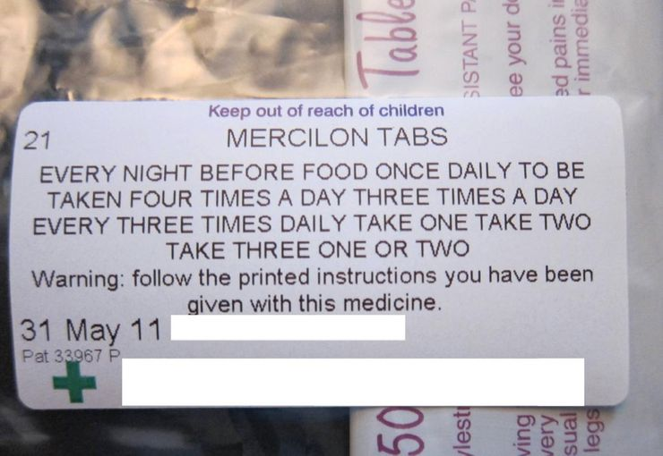
Take this medicine one, two, three or four times

Slide 3
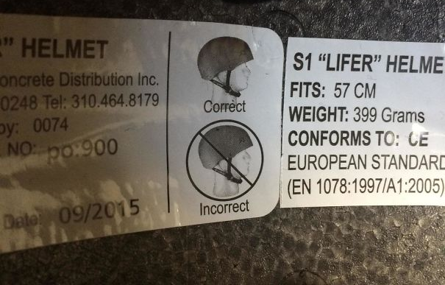
You’re doing it wrong! You’re still doing it wrong

Slide 4
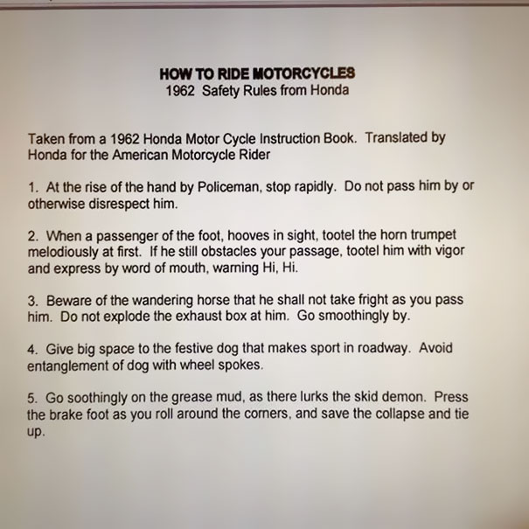
Riding a Honda Motorcycle

Slide 5
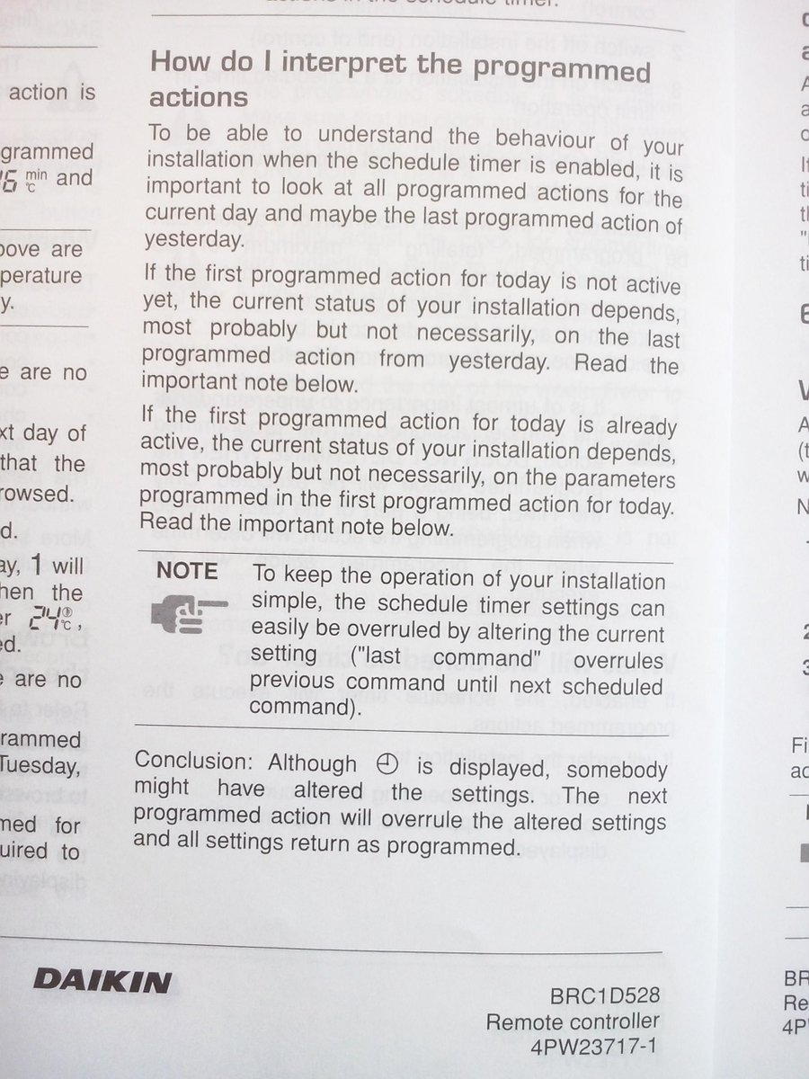
How do I interpret the programmed actions?

Slide 6
Instructions and User Guides
Consumer-Oriented instructions
Instructions written to facilitate clients, customers, employees etc who have non- engineering background
User guide –Product or a service
A comprehensive guide that includes instructions (along with other elements)

Slide 7
Approaches to Writing Instructions
Feature and function oriented approach
Task oriented approach

Slide 8
Feature and function oriented approach
Focuses on explaining/describing each button, switch, knob, menu, and option, as they function individually.
works if,
The product is simple
The labels are adequately self descriptive
Combination of feature are not needed to accomplish tasks

Slide 9
Task-oriented approach
Focus is on accomplishing a task as a result of a combination of functions or parts.
Works when,
The task is relatively more complex
A variety of steps is involved to accomplish a task
Should involve a “How to……” situation

Slide 10
Instructions: Writing style
Imperative mood:
Load paper print side down into the printer
For additional explanatory material:
Second person indicative mood:
“You may want to fan the paper to loosen it before loading it into the printer”

